Slide 1

Choosing an Order for Joins
Department of Computer Science
Johns Hopkins University

Slide 2
What is the best way to join n relations?
Hash-Join
SELECT …
FROM A, B, C, D
WHERE A.x = B.y
AND C.z = D.z
Sort-Join
Index-Join
A
B
C
D
Notes:
For join queries, need to determine both the join algorithm and order

Slide 3
Issues to consider for 2-way Joins
Join attributes sorted or indexed?
Can either relation fit into memory?
  Yes, evaluate in a single pass
  No, require Log_{M} B passes. M is #of buffer pages and B is # of pages occupied by smaller of the two relations
Algorithms (nested loop, sort, hash, index)
Smaller relation as left argument, why?

Slide 4
Nested Loop Join
L
R
L is left/outer relation
Useful if no index, and not sorted on the join attribute
Read as many pages of L as possible into memory
Single pass over L, B(L)/(M-1) passes over R
<1st M-1 tuples in L>
Read R one
tuple at
a time
<one tuple from R>
...
<last M-1 tuples in L>
Read R one
tuple at
a time
<one tuple from R>
Notes:
Assume 1 tuple per page

Slide 5
Sort Merge Join
L
R
L or R
Useful if either relation is sorted. Result sorted on join attribute.
Divide relation into M sized chunks
Sort the each chunk in memory and write to disk
Merge sorted chunks
Memory
Sorted
Chunks
...
Sorted file
Memory
Sorted
Chunks
...

Slide 6
Hash Join
L
R
L
R
Hash (using join attribute as key) tuples in L and R into respective buckets
Join by matching tuples in the corresponding buckets of L and R
Use L as build relation and R as probe relation
Hash
X_{L1}
X_{R1}
Buckets
...
...
X_{Ln}
X_{Rn}
Memory
X_{Li}
Hash
X_{Ri}
Build
Probe
Notes:
Hash function must be selected carefully
Build relation employs a different hash function

Slide 7
Index Join
L
R
Join attribute is indexed in R
Match tuples in R by performing an index lookup for each tuple in L
If clustered b-tree index, can perform sort-join using only the index
Index
Lookup
L
R
Notes:
Good on equality predicates in which L is small
Not always beneficial (ie. Almost all tuples in R succeed in the join)

Slide 8
Ordering N-way Joins
Joins are commutative and associative
  (A B) C = A (B C)
Choose order which minimizes the sum of the sizes of intermediate results
  Likely I/O and computationally efficient
  If the result of A B is smaller than B C, then choose (A B) C
Alternative criteria: disk accesses, CPU, response time, network
Notes:
Intermediate result sizes is simple to estimate and provides good estimates. More detailed criteria require knowledge of join algorithm or info at runtime

Slide 9
Ordering N-way Joins
Choose the shape of the join tree
  Equivalent to number of ways to parenthesize n-way joins
  Recurrence: T(1) = 1
  T(n) = Σ T(i)T(n-i), T(6) = 42
Permutation of the leaves
  n!
For n = 6, the number of join trees is 42*6! Or 30,240

Slide 10
Shape of Join Tree
D
C
A
B
C
D
B
A
Left-deep Tree
Bushy Tree

Slide 11
Shape of Join Tree
A left-deep (right-deep) tree is a join tree in which the right-hand-side (left-hand-side) is a relation, not an intermediate join result
Bushy tree is neither left nor right-deep
Considering only left-deep trees is usually good enough
  Smaller search space
  Tend to be efficient for certain join algorithms (order relations from smallest to largest)
  Allows for pipelining
  Avoid materializing intermediate results on disk

Slide 12
Searching for the best join plan
Exhaustively enumerating all possible join order is not feasible (n!)
Dynamic programming
  use the best plan for (k-1)-way join to compute the best k-way join
Greedy heuristic algorithm
  Iterative dynamic programming

Slide 13
Dynamic Programming
The best way to join k relations is drawn from k plans in which the left argument is the least cost plan for joining k-1 relations
BestPlan(A,B,C,D,E) = min of (
BestPlan(A,B,C,D) E,
BestPlan(A,B,C,E) D,
BestPlan(A,B,D,E) C,
BestPlan(A,C,D,E) B,
BestPlan(B,C,D,E) A )
Notes:
Least cost join order for any subset of relations is computed once

Slide 14
Complexity
Finds optimal join order but must evaluate all 2-way, 3-way, …, n-way joins (n choose k)
Time O(n*2^{n}), Space O(2^{n})
Exponential complexity, but joins on > 10 relations rare
Notes:
Sum of n choose k
Left-deep tree only

Slide 15
Dynamic Programming
Choosing the best join order or algorithm for each subset of relations may not be the best decision
  Sort-join produces sorted output that may be useful (i.e., ORDER BY/GROUP BY, sorted on join attribute)
  Pipelining with nested-loop join
  Availability of indexes
Notes:
Intermediate result size may not always be the best cost metric
pipelining, first results are produced quickly, avoids materialization
Hash join may be cost effective, but if later relations sorted on join attribute, best to use sort-join (example)

Slide 16
Dynamic Programming
70s, seminal work on join order optimization in System R
Interesting order (extension)
Identify interesting sort order. For each order, find the best plan for each subset of relations (one plan per interesting property)

Slide 17
Dynamic Programming
BestPlan(A,B,C,D; sort order) = min of (
BestPlan(A,B,C; sort order) D,
BestPlan(A,B,D; sort order) C,
BestPlan(A,C,D; sort order) B,
BestPlan(B,C,D; sort order) A )
Low overhead (few interesting orders)

Slide 18
Partial Order Dynamic Programming
Optimization of multiple goals (i.e., response time, network cost, throughput)
  Each plan assigned an p-dimensional cost vector (generalization of interesting orders)
  Two plans are incomparable if neither is less than the other in all cost dimensions
  Keep set of incomparable but optimal plans
Complexity, 2^{p} explosion in search space (O(2^{p}*n*2^{n}) time, O(2^{p}*2^{n}) space)

Slide 19
Heuristic Approaches
Dynamic programming may still be too expensive
Sample heuristics:
  Join from smallest to largest relation
  Perform the most selective join operations first
  Index-joins if available
  Precede Cartesian product with selection
Most systems use hybrid of heuristic and cost-based optimization
Notes:
Heuristic algorithms that rely on iterative improvement/simulated annealing

Slide 20
Iterative Dynamic Programming
Compute the best k-way join at each iteration (choose k to prevent thrashing - memory constraint O(2^{k}))
BestPlan(A,B,C,D,E,F), k=3
  Iteration 1: Let the best 3-way join be A B D = Φ
  Iteration 2: Given {Φ,C,E,F}, find the best 3-way join

Slide 21
Distributed Join Processing
Centralized database is attractive for updates/maintenance
Database federations (Astronomy, Biology)
Different set of challenges (disk I/O or intermediate result sizes may not be appropriate cost metrics)
  Large datasets across many sites
  Heterogeneous environment
  Network heterogeneity
Early prototypes (System R*, SDD-1, Distributed Ingres)

Slide 22
Distributed Join Processing
Offers opportunity for parallelism
Issues
  Left-deep trees no longer sufficient (larger search space, attractive to use heuristic algorithms)
  Bushy plans may eliminate indexes
  Additional cost models (response time, network cost, economic models)
Notes:
Restricting to left deep trees make sense in single processor environments
Queries may be network-bound, intermediate result size may be sufficient on uniform networks but not over wan
Minimizing response time tend to overuse resources
Randomized algorithms

Slide 23
Mermaid
An early test-bed for federated database systems (front-end)
Optimize for both network and processing cost (models disk I/O, CPU, load, link speed)
Two query optimization algorithms to exploit parallelism
  Semi-join (reduce communication cost)
  Data replication (distribute query processing)
Notes:
placement and generation of replicated data

Slide 24
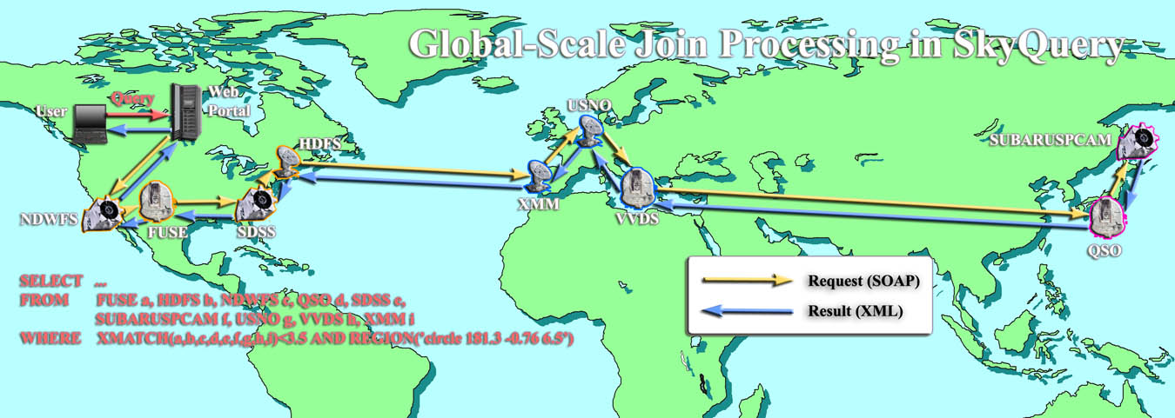
Global-scale Database Federation

